Slide 1
Lecture 4
Tissues. Classification and Origin of Tissues. Epithelial Tissues.

Slide 2
Histology
Histology is the study of cells, tissues and organs as seen through the microscope. The importance of histology is that it is the structural basis for cell, tissue and organ biology and function (physiology) and disease (pathology).

Slide 3
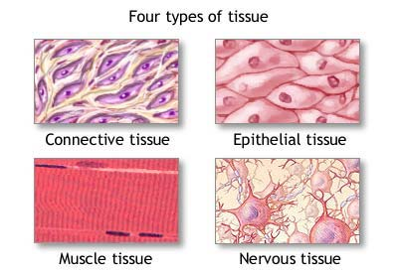
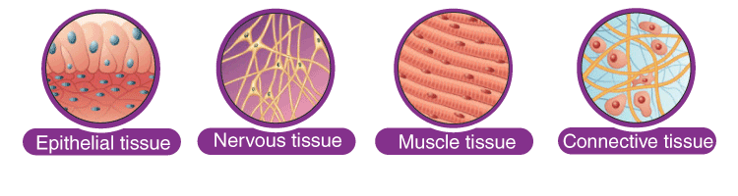
The organs in the body are composed of four basic types of tissue, including:
Epithelial.
Connective.
Muscular.
Nervous.

Slide 4
What is the epithelium?
The epithelium is a type of body tissue that forms the covering on all internal and external surfaces of body, lines body cavities and hollow organs and is the major tissue in glands.

Slide 5
What are epithelial cells?
Epithelial tissue is made up of epithelial cells. The cells can be different shapes and can be arranged in a single layer or multiple layers depending on where they are in body and what kind of functions they have.
In biology, a cell is the smallest unit that can live on its own. Cells make up all living organisms and the tissues of body. More than 30 trillion cells make up body.
A cell has three main parts:
The cell membrane: The cell membrane surrounds the cell and controls the substances that go into and out of the cell.
The nucleus: The nucleus is a structure inside the cell that contains most of the cell’s DNA (genetic material).
The cytoplasm: The cytoplasm is the fluid inside the cell. It contains other cell parts that have certain functions.

Slide 6
Some types of cells, including some epithelial cells, have characteristics on the surface of the cell that help them perform certain functions, including:
Microvilli: Microvilli are non-motile (they don’t move) finger-like structures on the surface of epithelial cells that function to increase the cell’s surface area so that it can better absorb substances. The epithelial cells that line small intestine have thousands of microvilli that absorb nutrients from the food and protect body from intestinal bacteria.
Cilia: Cilia are tiny, hair-like, motile (they can move) structures on the surface of the cell that help move entire cells or can move substances along the outer surface of the cell. Ciliated cells usually have hundreds of cilia on their surfaces. Epithelial cells lining your respiratory tract have cilia that trap dust and other substances you breathe in and move them toward your nostrils so that they don’t go into your lungs. Another example of cells with cilia are the epithelial cells that line the fallopian tubes that help move an egg from an ovary to the uterus.
Stereocilia: Stereocilia are specialized microvilli that resemble cilia and project from the surface of certain epithelial cells. Stereocilia are needed on the epithelial tissue in your inner ear for hearing and balance.

Slide 7
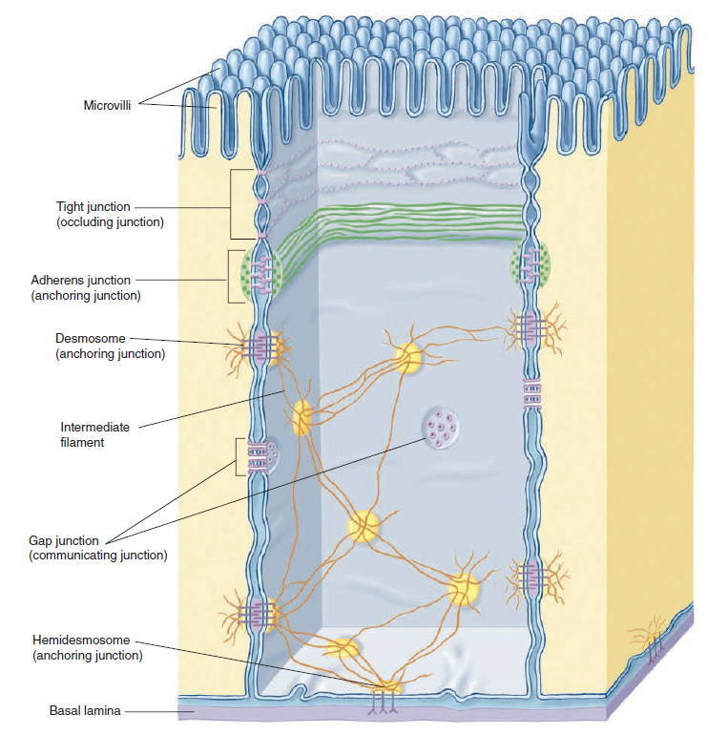

Slide 8
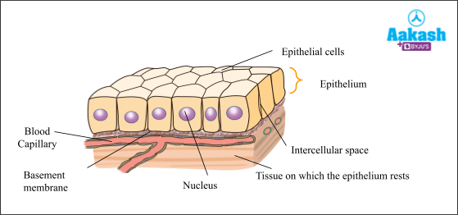
Structure of Epithelial Tissue
Epithelial tissue is formed from a tightly fitted continuous layer of cells. One surface of the epithelial tissue is exposed to either the external environment or the body fluid. The other surface is attached to tissue by a membrane, which consists of fibers and polysaccharides secreted by epithelial cells.
There is little intercellular material present between cells. There are specialized junctions present between the cells of the epithelium that link individual cells.

Slide 9
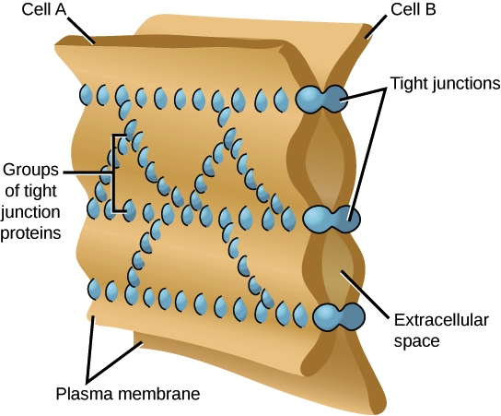
Tight junctions- prevent leakage across tissues

Slide 10
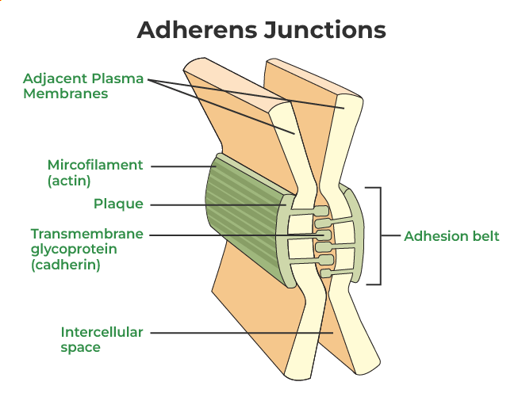
Adhering junctions- keep the neighboring tissues well cemented together

Slide 11
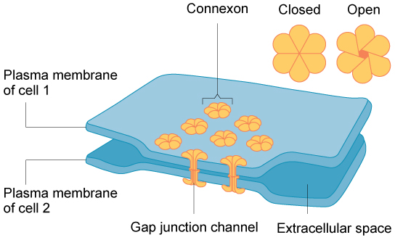
Gap junctions- facilitate
the movement of ions
and molecules across the tissue

Slide 12
Epithelial cells form membranes. The epithelial membrane consists of a layer of epithelial tissue and has underlying connective tissue.
There are two types of epithelial membranes:
mucous membrane
serous membrane.

Slide 13
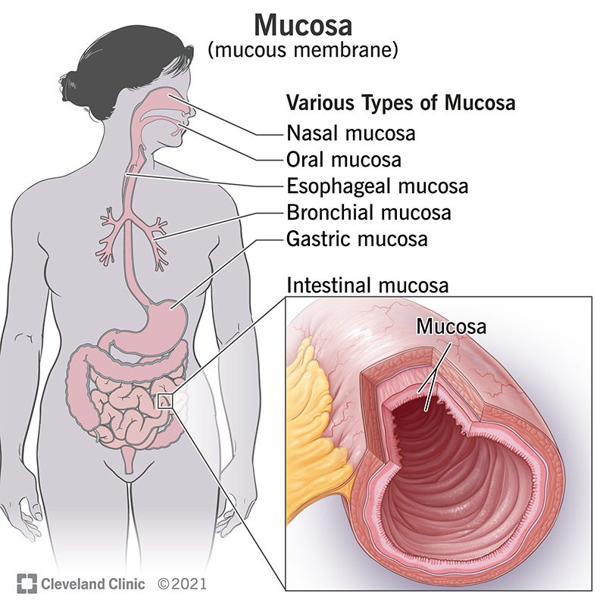
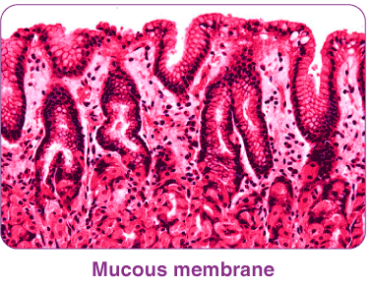
Mucous membrane:
It is also known as mucosa. There are goblet cells present, which secrete mucus. The mucus helps in lubrication, protection and easy movement of materials. It prevents tissues from drying. It lines the body cavities such as respiratory and digestive tracts, which open outside the body.

Slide 14
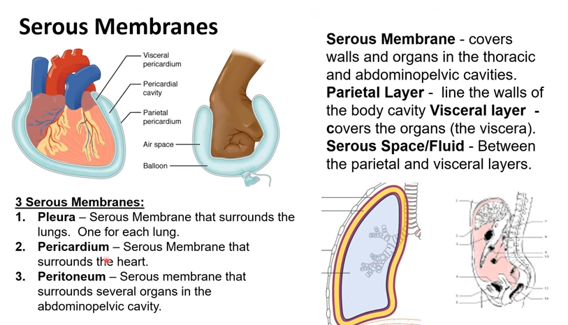
Serous membrane:
The serous membrane lines the body cavities, which do not open outside the body, such as the lining of the pleural cavity, pericardial membranes. These membranes secrete the fluid inside the cavity and are made up of simple squamous epithelium.

Slide 15
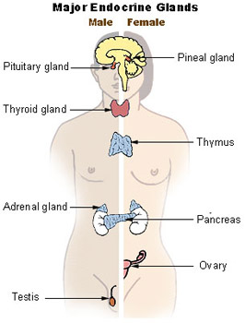
Glands
are made up of epithelial cells. There are two types of glands, exocrine and endocrine. Exocrine glands secrete their product into a duct, e.g. goblet cells, sweat glands. Endocrine glands are called ductless glands and they release their product directly into the blood or intestinal fluid, e.g. hormones.

Slide 16
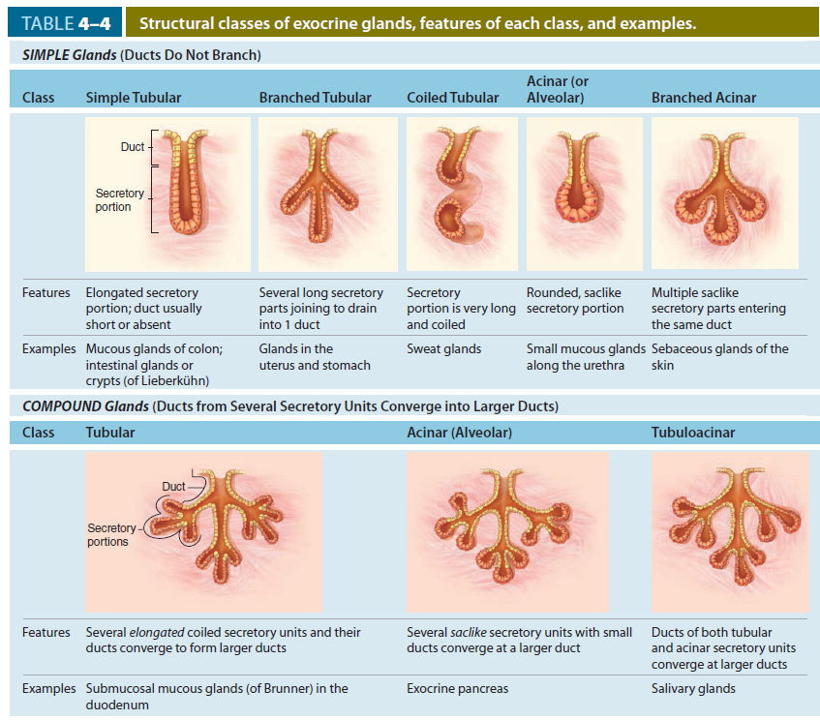

Slide 17
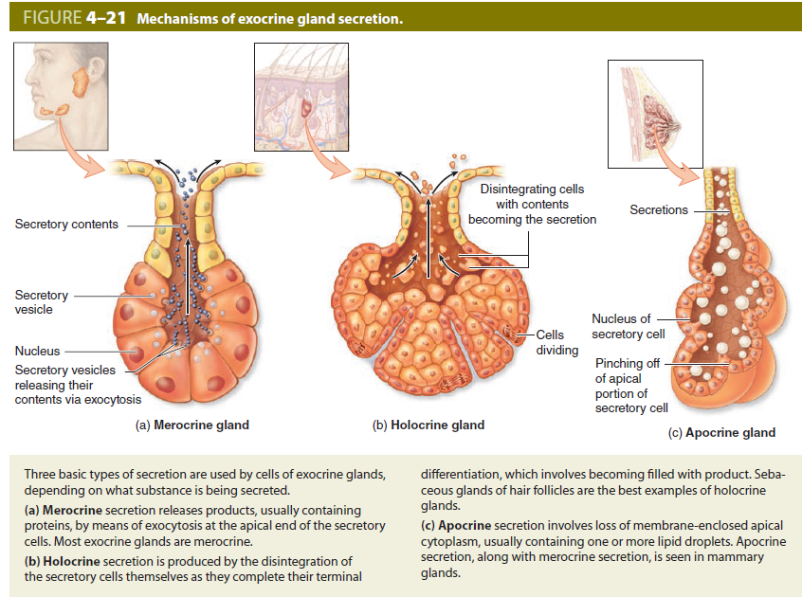

Slide 18
What are the different types of epithelial cells?
There are several different types of epithelial cells because epithelial tissues have many different functions depending on where they are in your body.

Slide 19
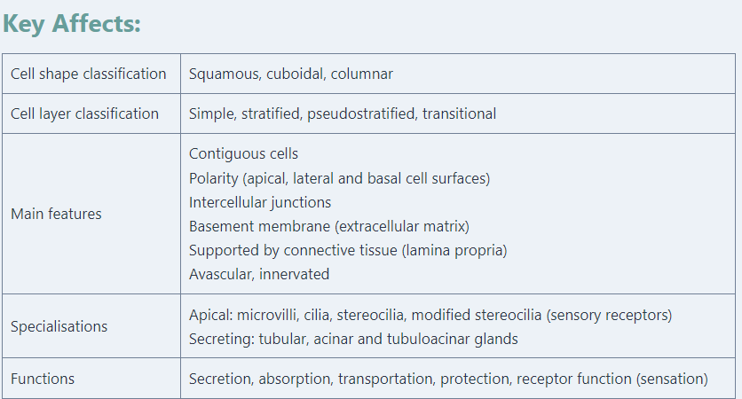

Slide 20
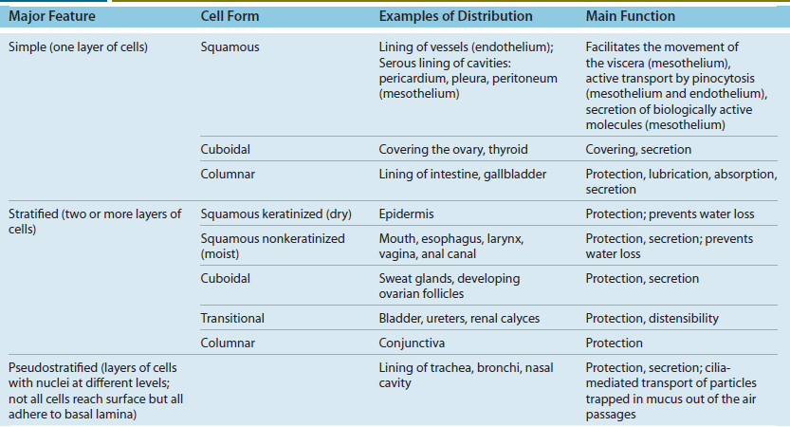

Slide 21
Types of epithelial cells based on their shape
Different types of epithelial cells based on shape include:
Squamous epithelium: Squamous epithelial cells are flat and sheet-like in appearance.
Cuboidal epithelium: Cuboidal epithelial cells are cube-like in appearance, meaning they have equal width, height and depth.
Columnar epithelium: Columnar epithelial cells are column-like in appearance, meaning they are taller than they are wide.

Slide 22
Types of epithelial cells based on their arrangement
Epithelial tissue can also vary based on how the cells are arranged. The descriptors, or adjectives, for the way the cells are arranged, include:
Simple: A simple epithelium means that there’s only one layer of cells.
Compound (Stratified): A stratified epithelium is made up of more than one layer of cells.
Pseudostratified: A pseudostratified epithelium is made up of closely packed cells that appear to be arranged in layers because they’re different sizes, but there’s actually just one layer of cells.

Slide 23
Epithelial cells based on specialized functions
Transitional epithelium: A transitional epithelium (also known as urothelium) is made up of several layers of cells that become flattened when stretched. It lines most of your urinary tract and allows your bladder to expand.
Glandular epithelium: This type of epithelium is specialized to produce and secrete (release) substances. It’s found in your glands, which are specialized organs that can make, store and/or release substances such as hormones, proteins and water.
Olfactory epithelium: The olfactory epithelium, located within your nasal cavity, contains olfactory receptor cells, which have specialized cilia extensions. The cilia trap odor molecules you breathe in as they pass across the epithelial surface. Information about the molecules is then transmitted from the receptors to the olfactory bulb in your brain, where your brain then interprets the smell.

Slide 24
Epithelial Tissue Functions
Protection: As it covers the entire body surface, it is the first line of defence against any kind of mechanical injury, chemical exposure, excessive fluid loss and infections. Ciliary projections present in the nose or upper respiratory tract, trap the dust particles and prevent it from entering the body
Absorption: The epithelial lining of the digestive tract absorbs water and nutrients
Exchange of substances: Epithelial tissue regulates the exchange of substances between body and external environment as well as the internal exchange between different parts of the body. Everything that enters the body or enters the bloodstream by absorption has to cross the epithelial barrier
Sensation: Sensory receptors are present in the epithelial tissue of the nose, eyes and ears, taste bud, etc. that help in transmitting signals from the external stimuli to the brain
Secretion: Various glands made up of epithelial cells secrete hormones, enzymes, saliva, mucus, sweat, etc.

Slide 25
Types of Epithelial Tissue | Location | Structure | Function
Simple squamous | Blood vessel lining, air sac lining of lungs | A single layer of flat cells having irregular boundaries | Transport by diffusion and where minimal protection is required
Simple Cuboidal Epithelium | The tubular lining of kidneys, glandular ducts | A single layer of short cylindrical cells. It may have microvilli as in proximal convoluted tubules | Absorption and secretion
Simple Columnar Epithelium | Digestive tract and upper respiratory tract lining | A single layer of columnar cells (tall and slender) and often ciliated | Protection, absorption, mucus secretion and movement in a specific direction

Slide 26
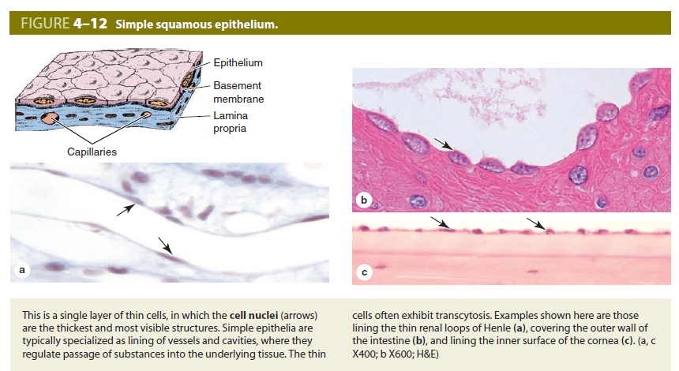

Slide 27
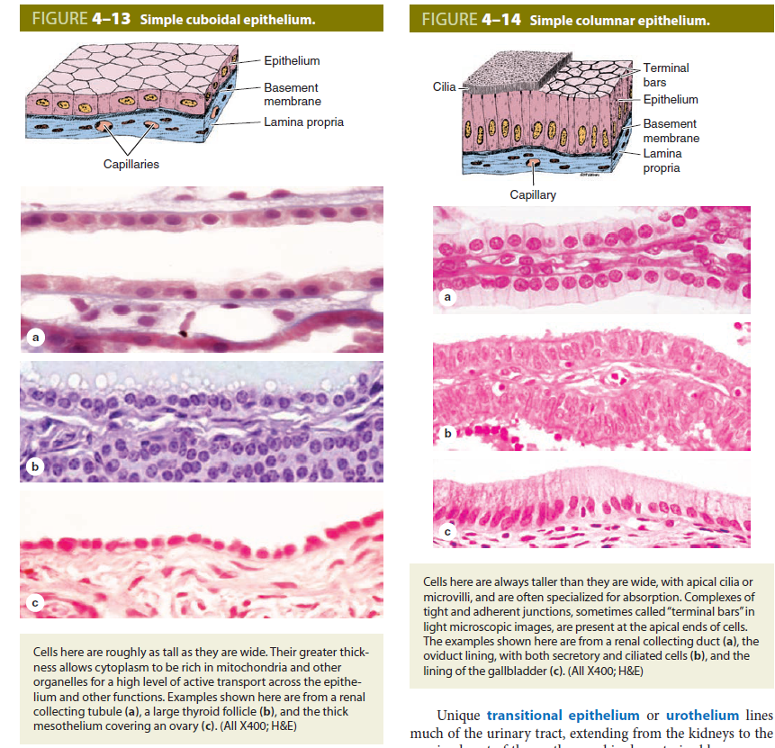

Slide 28
Stratified Squamous Epithelium | The lining of the mouth and vagina | Made up of several layers of cells, continuously sloughed off and regenerated. The older layer of cells is pushed upwards and becomes flat. The lower layer is columnar and metabolically active | Protection
Stratified Cuboidal | Mammary glands, sweat gland and salivary glands | The upper layer is cuboid and other layers may be cuboidal or other types | Protection of ducts of various glands
Stratified Columnar | Male urethra and lobar ducts of salivary glands | There is a layer of columnar cells present on squamous, columnar or cuboidal epithelial cells | Protection and secretion

Slide 29
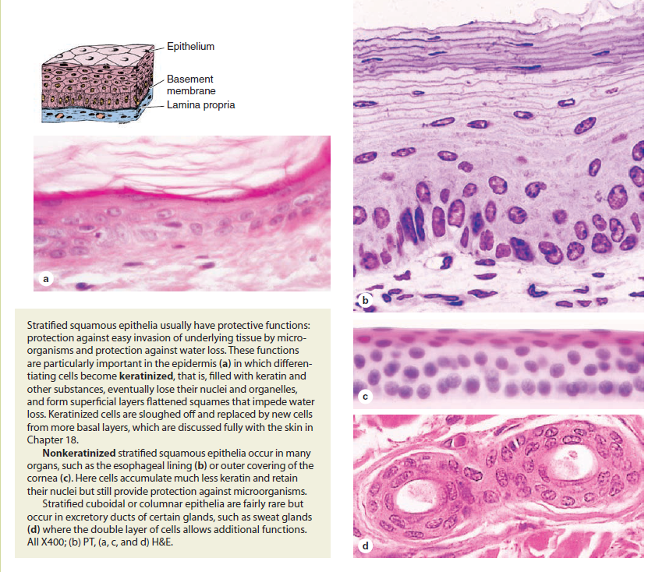

Slide 30
Pseudostratified Columnar | Respiratory passage and ducts of many glands | Similar to columnar epithelium but all the cells are not of similar height | Protection, secretion and movement of mucous
Transitional epithelia or urothelium | Urinary bladder, urethra, ureter | Stratified epithelium, which can contract or expand as per the requirement. Cells are cuboidal when not stretched, but when the organ stretches, then tissue gets compressed and cells appear irregular and squamous-shaped | Stretch readily to accommodate the different volume of liquids Act as a barrier and have tight junctions to prevent reabsorption of toxic substances
Keratinised | The outer or apical layer of the cell | Mostly dead and devoid of nucleus and cytoplasm. The cytoplasm gets replaced by keratin, which makes the layer waterproof | Protection against abrasion

Slide 31
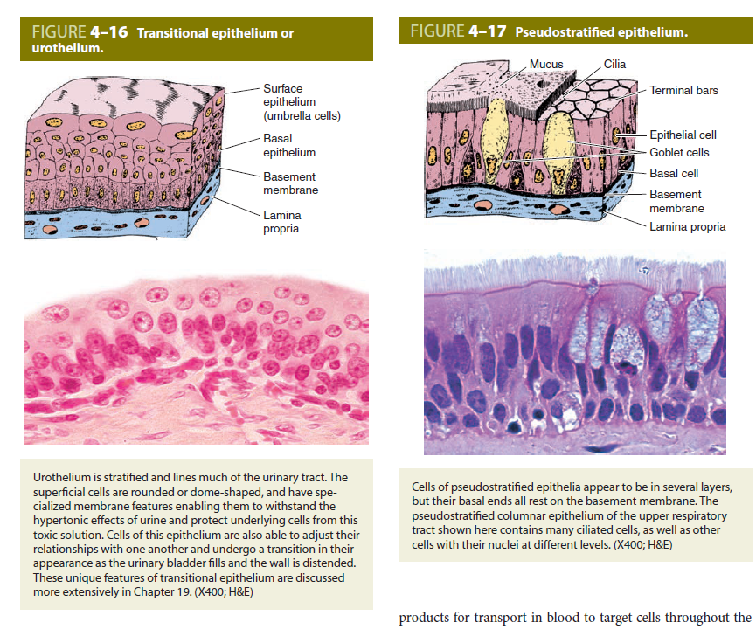

Slide 32
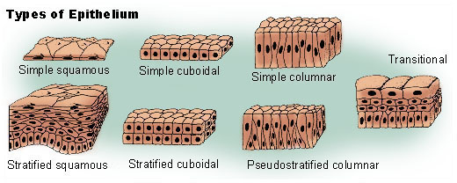

Slide 33
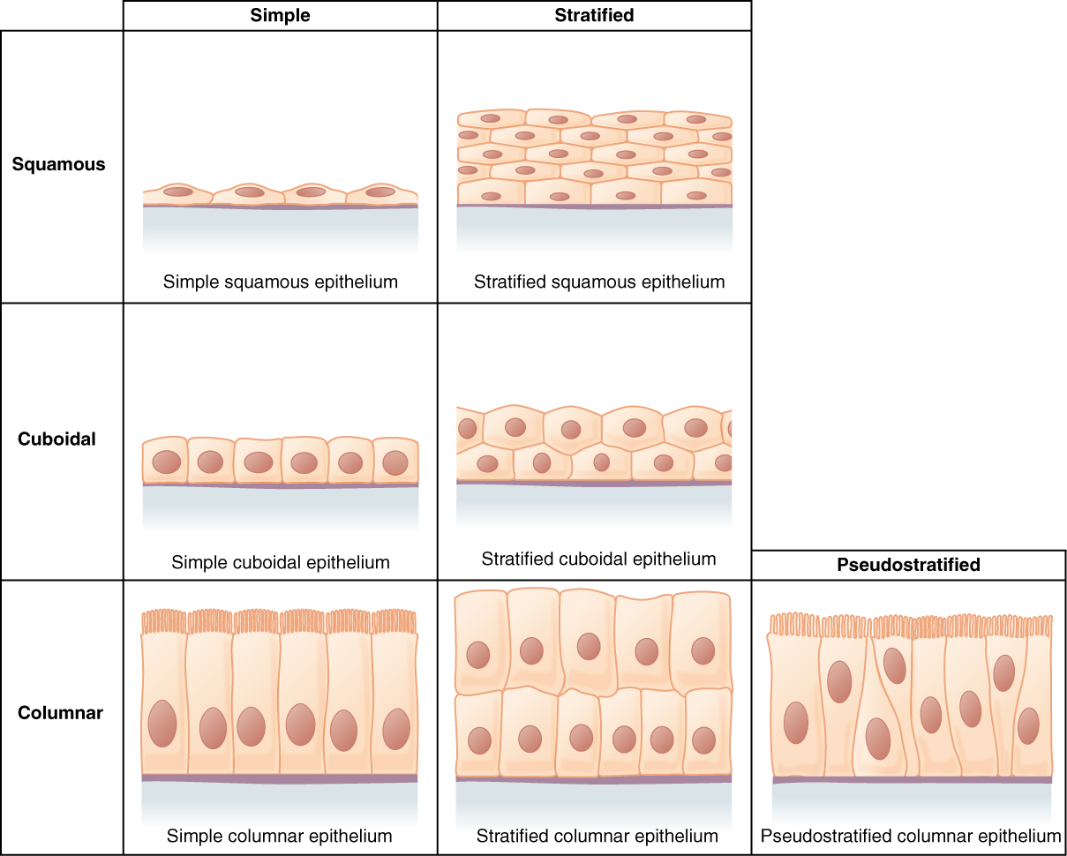

Slide 34
